Slide 1
Are you going to Solar Summer Camp with Sunpower?
Porterville High School
Alternative Energy Resource Occupations
CPA Green Academy

Slide 2
About the Porterville High School AERO Academy
AERO – CA Partnership “Green” Academy
Alternative Energy Resource Occupations
To prepare students for College and Career opportunities
Main Focus- Renewable or Alternative Energy Technology:
Solar, Wind, Biomass, Geothermal, Hydroelectricity,
Building Trades-Green Construction and Building Performance
Transportation-Alternative Energy Drivetrain & Fuels
Porterville High School-located in the Central Valley against the Sierra Nevada Mountains between Fresno and Bakersfield

Slide 3
AERO Academy Mission Statement
The mission of AERO is to provide students a dynamic, engaging and effective educational experience that prepares students with the skills to be productive citizens in a global society. AERO emphasizes academic preparation for “college and career”, with skills for success in the real world. Students work as a team with teachers, businesses, technical experts and mentors. Students focus on Energy and Green Technology as a career field of study, engaged in rigorous core curriculum, blended with demanding technical skills, and real world experience.

Slide 4
Sunpower Corporation
PUSD partnered with Sunpower and installed a 7.3 MW Solar system in 2012 at our high school/adult school campuses, 693 KW on the PHS Campus
AERO had partnered and developed with Sunpower a Summer Solar Camp for internship opportunities for AERO students
Sunpower has made information and technology available to our students in the classroom.

Slide 5
Solar Summer Camp
The purpose of the camp is to educate students on the understanding, theory, design, and purpose of a residential solar energy system
Students will first attend a two-day OSHA 10 training session to earn their OSHA certification.
Students will go to “camp” for five days to learn about the process of designing, installing, and the marketing of a residential solar energy system

Slide 6
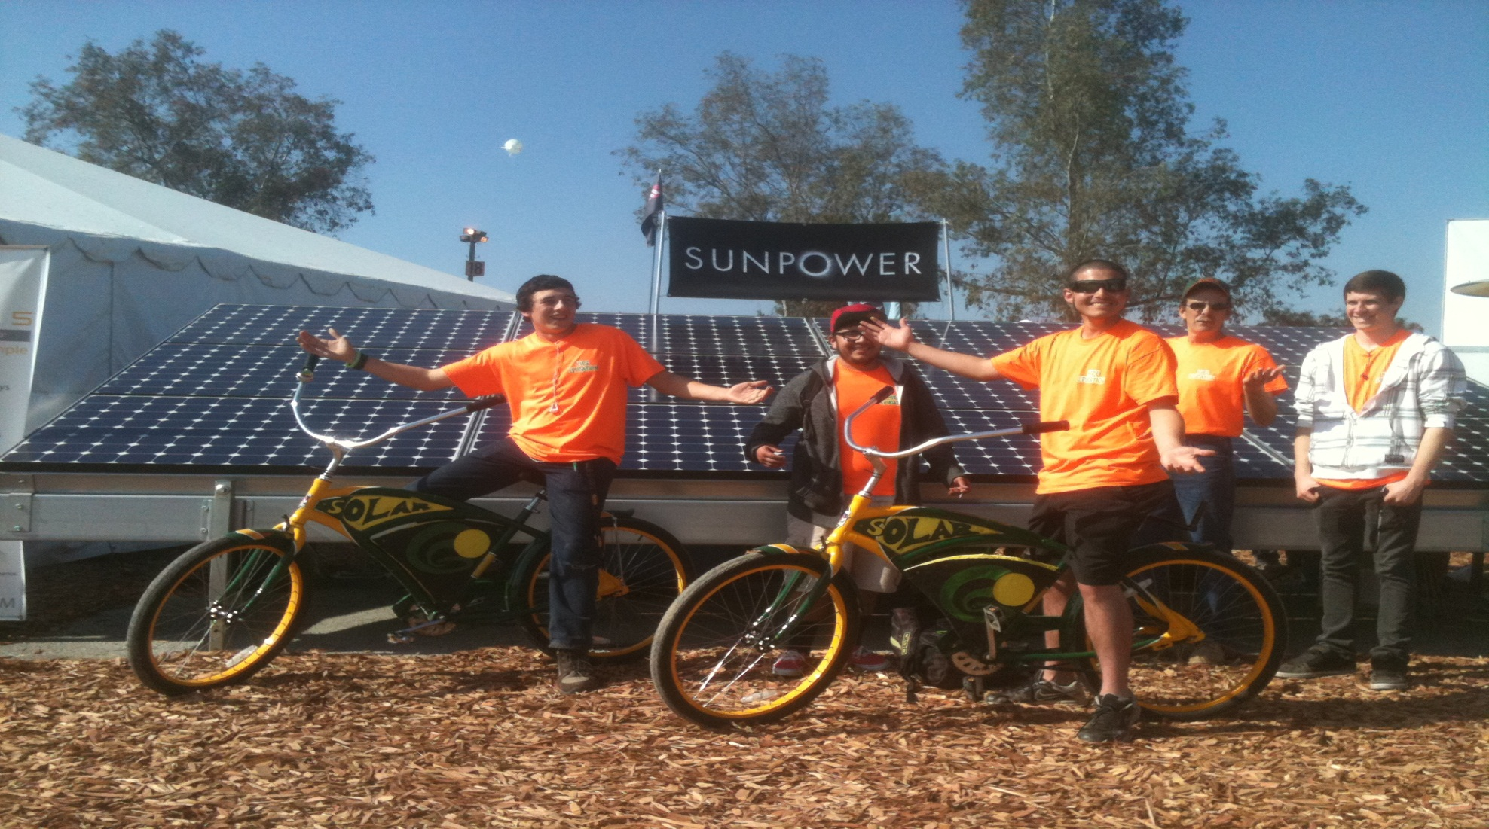
We LOVE Sunpower!

Slide 7
OSHA 10 Construction Certification
Intro to OSHA
OSHA Focus Four
Fall Protection
Electrical
Struck-by
Caught in/between
Personal Protective Equipment
Health Hazards
Materials Handling
Tools-Hand & Power
Scaffolds
Excavations
Stairways and Ladders
Cranes, Derricks, Hoists, Elevators, and Conveyors

Slide 8
Sunpower Solar Summer Camp-Day One Intro to Energy
Students are introduced to the basics of Electrical Theory and Practice
Students learn about AC/DC Electrical Theory
Students learn the four parts of a circuit
Students learn to use a digital multimeter (DVOM) and its functions
Students are introduced to Solar Energy and the environment
Solar Construction and Management Process
Electrical Theory
AC/DC power
AC/DC Conversion
Parts of a circuit
Insulators
Conductors
Electrical Measurements
Electrical Safety
Solar Construction Project Tour
Students break into student teams for Presentations

Slide 9
Sunpower Solar Summer Camp - Day One
Icebreaker: Student/Teacher team exercise
Morning Lecture: Intro to Energy, Hands-on Circuitry Experience
Afternoon Lecture: Intro to Week-Long Hands-On Project: Goals & objectives, rubrics, small group development, group exercise, final presentation
Afternoon Activity: Field trip to visit Solar PV installation-Harmony Magnet Academy

Slide 10
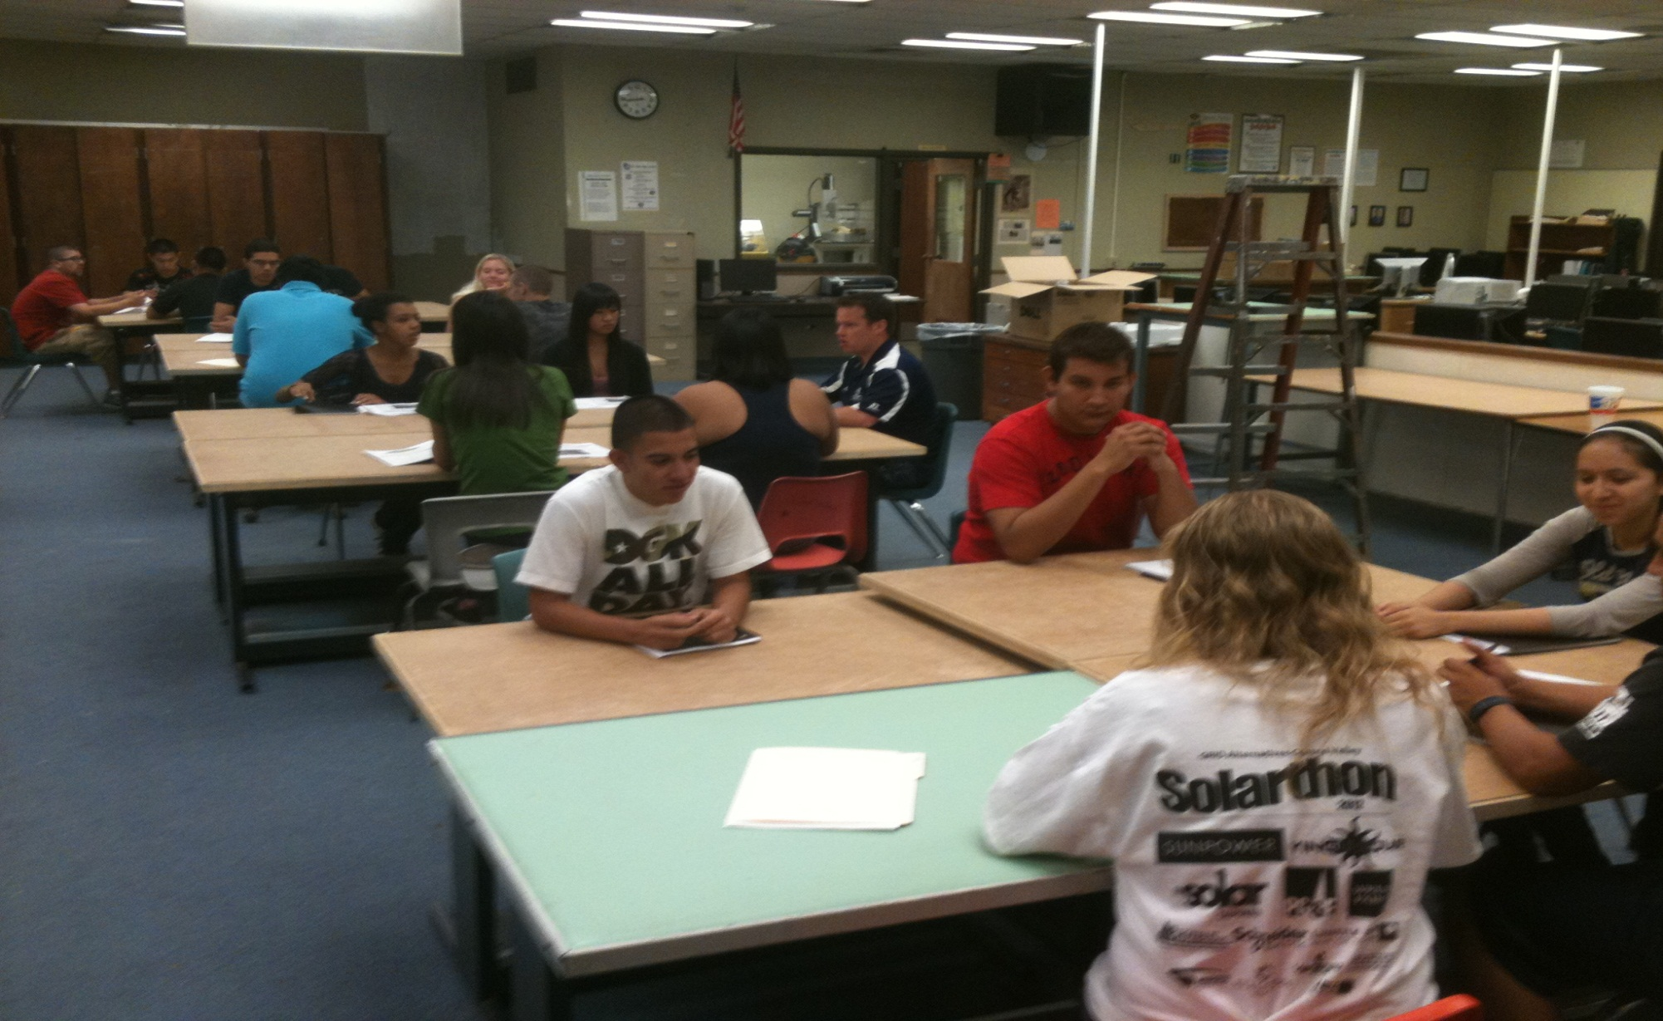
Solar Summer Camp-Day One

Slide 11
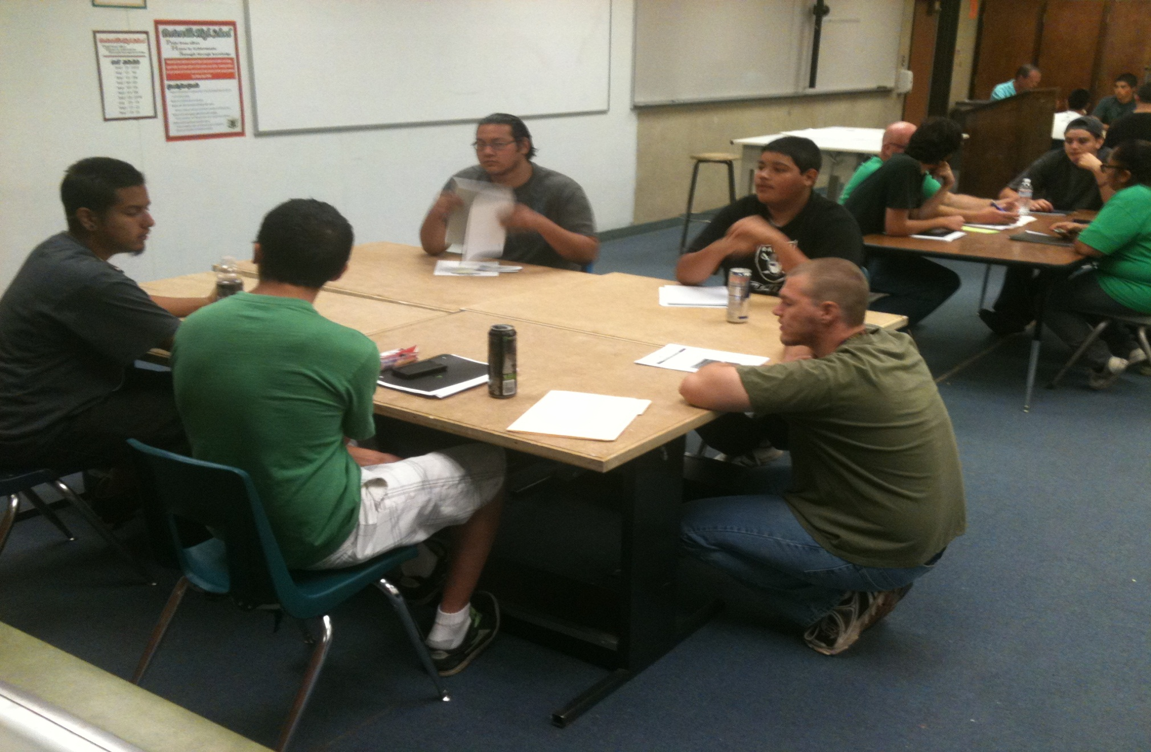
Solar Summer Camp-Day One

Slide 12
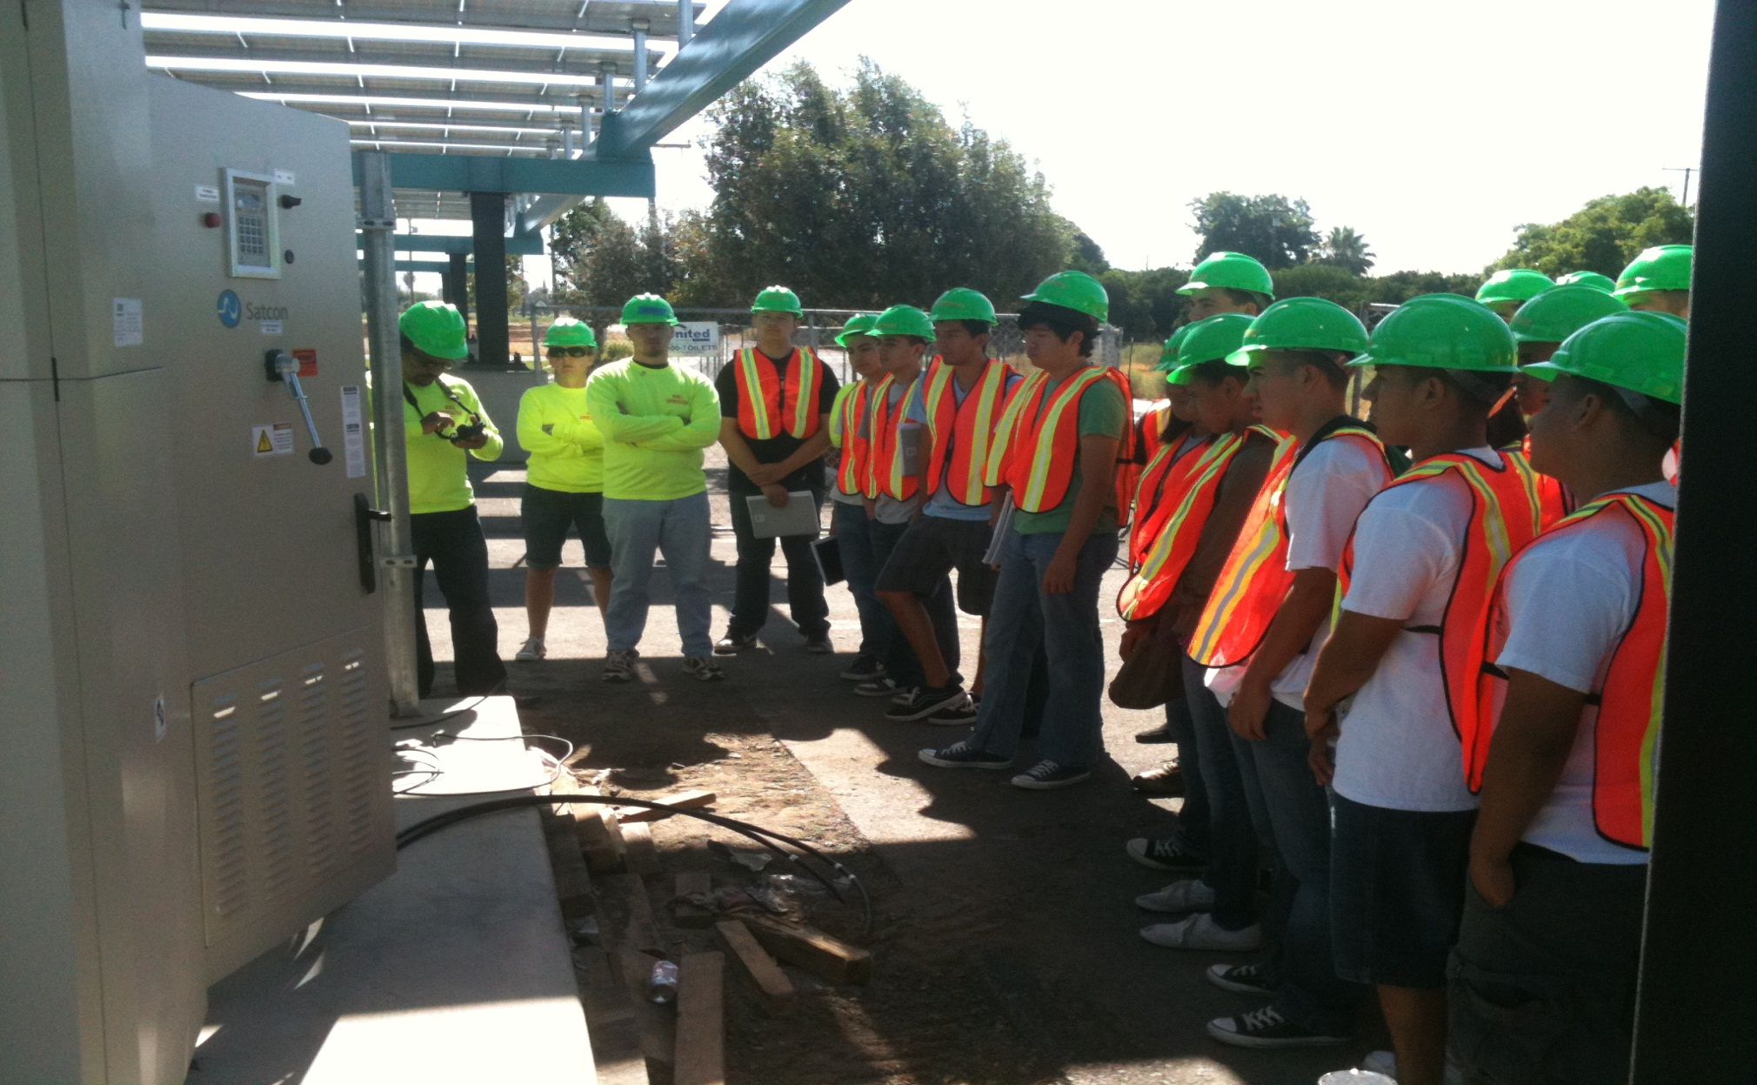
Sunpower Solar Summer Camp-Day One

Slide 13
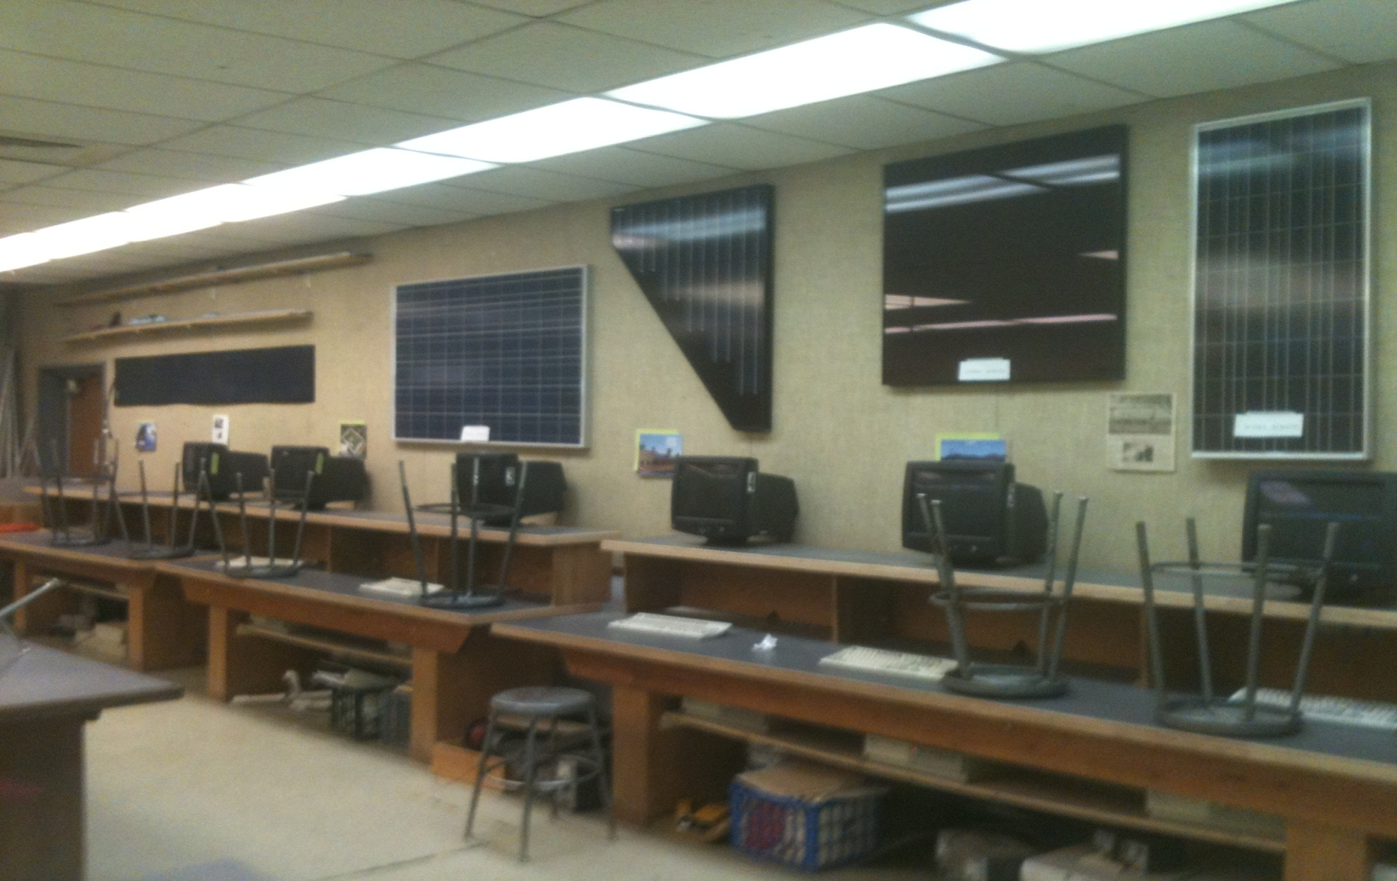
Sunpower Solar Summer Camp-Electronics Lab

Slide 14
Sunpower Solar Summer Camp-Day Two
Alternative Energy sources-Solar, Wind, Hydro, Geothermal, Biofuels Technologies
Research-Eco-footprint & Collective Impact
Field trip-SCE’s EET (AGTAC) Education and Training Facility (including Lunch)
Introduce students to group projects and timeline, introduce GoogleEarth, mapping tools

Slide 15
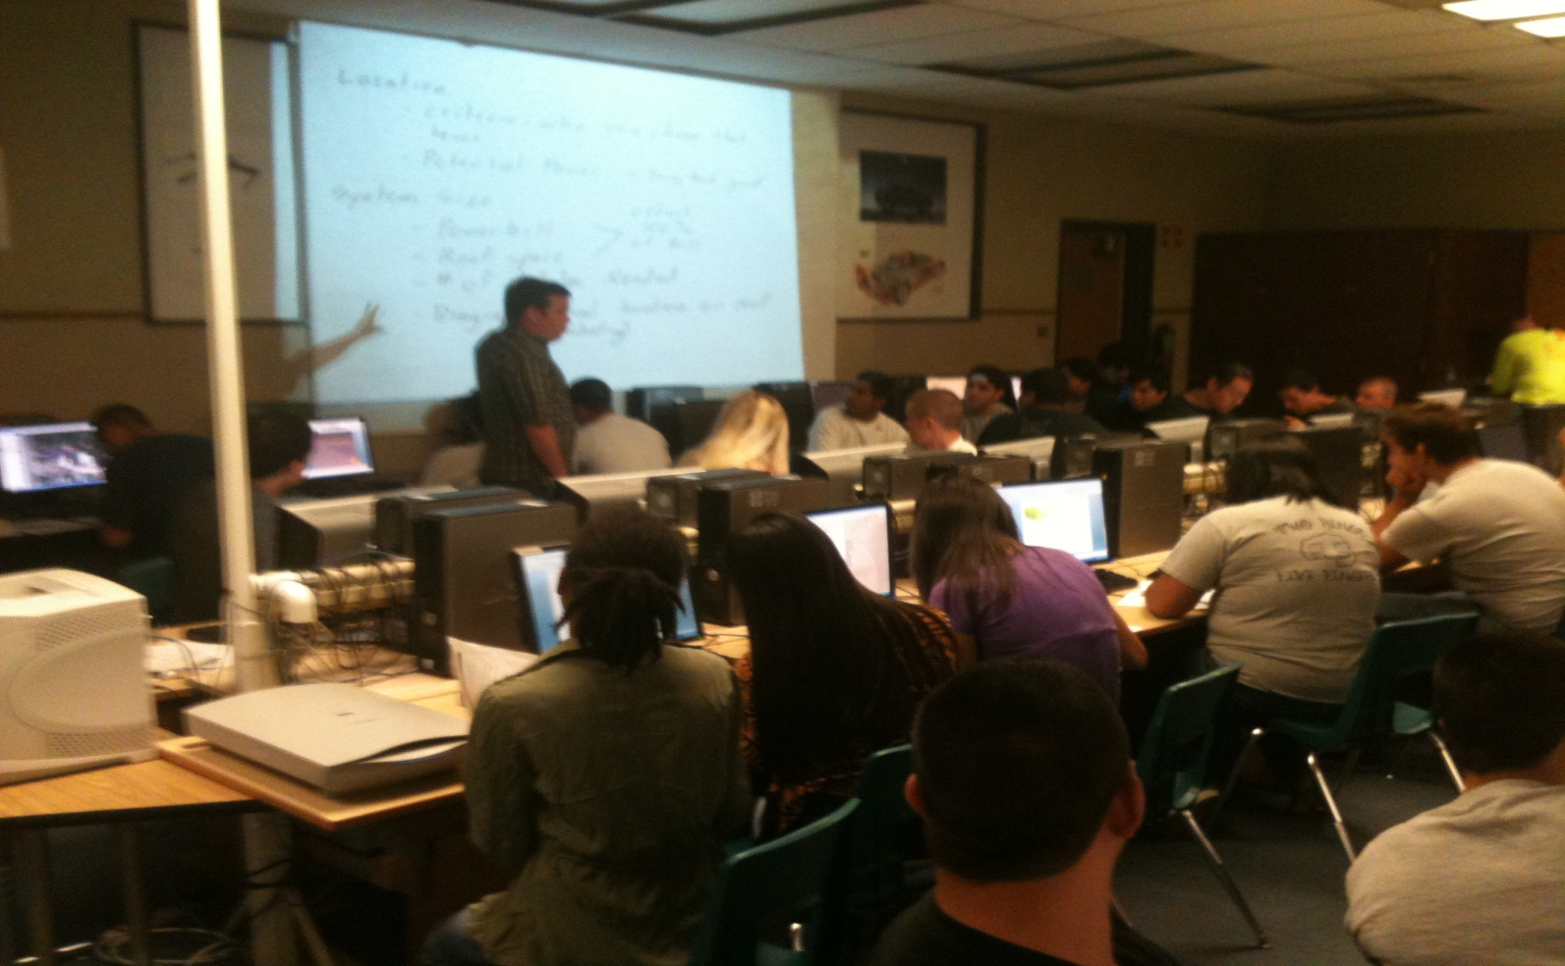
Sunpower Solar Summer Camp-Day Two

Slide 16
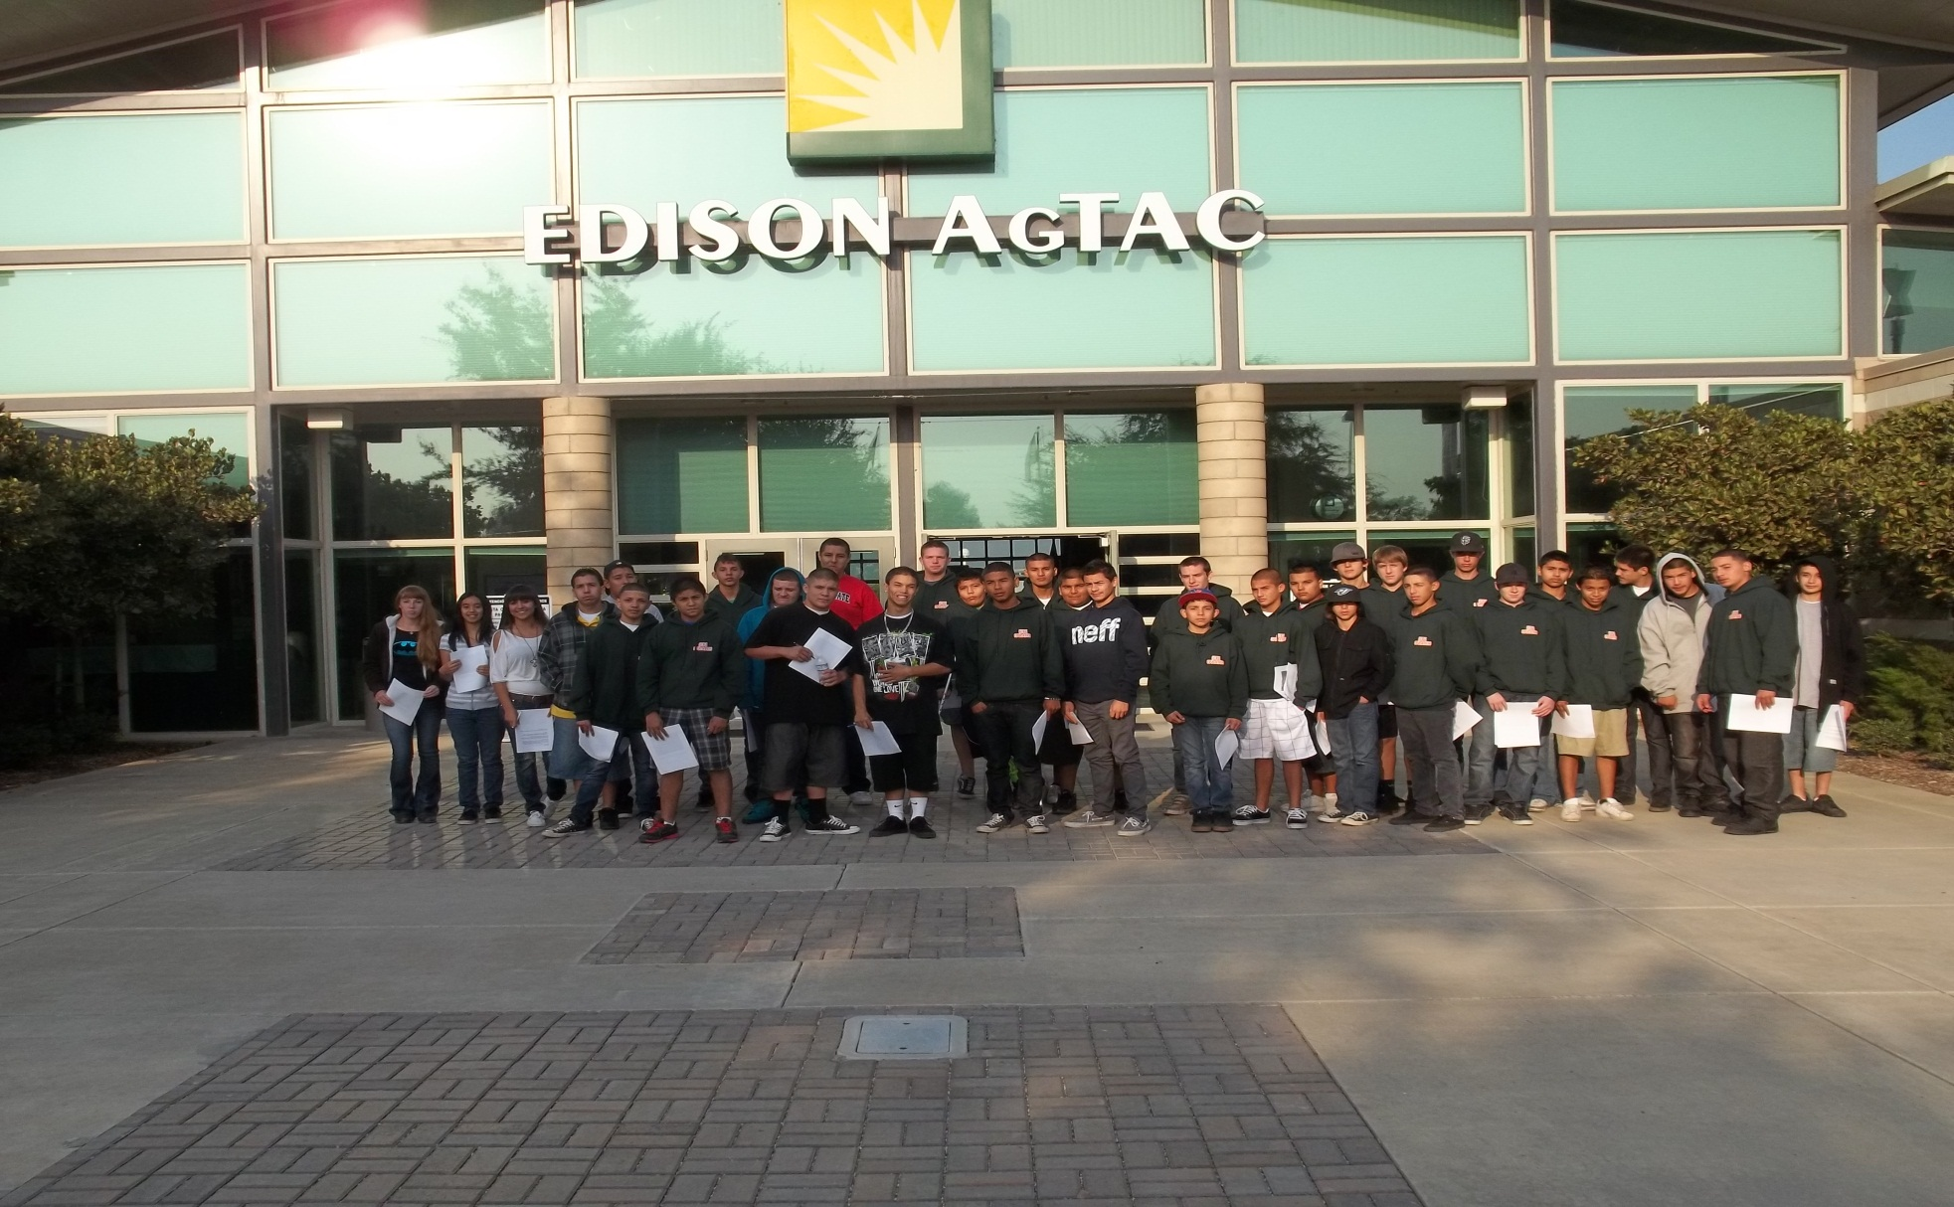
Sunpower Solar Summer Camp- Day Two

Slide 17
Sunpower Solar Summer Camp-Day Two

Slide 18
Sunpower Solar Summer Camp-Day Three
Icebreaker activity
Keynote Activity-2012
Economics of Solar Schools-Adding up the Benefits
Dr. Ken Gibbs-PUSD
Afternoon-Tour of SCE PV Solar field-partnership with City of Porterville
Project Design Brief-Students continue hands-on
Student Teams Presentation Development -continue to Google Earth, mapping house locations, begin system design, use string-sizing tool

Slide 19
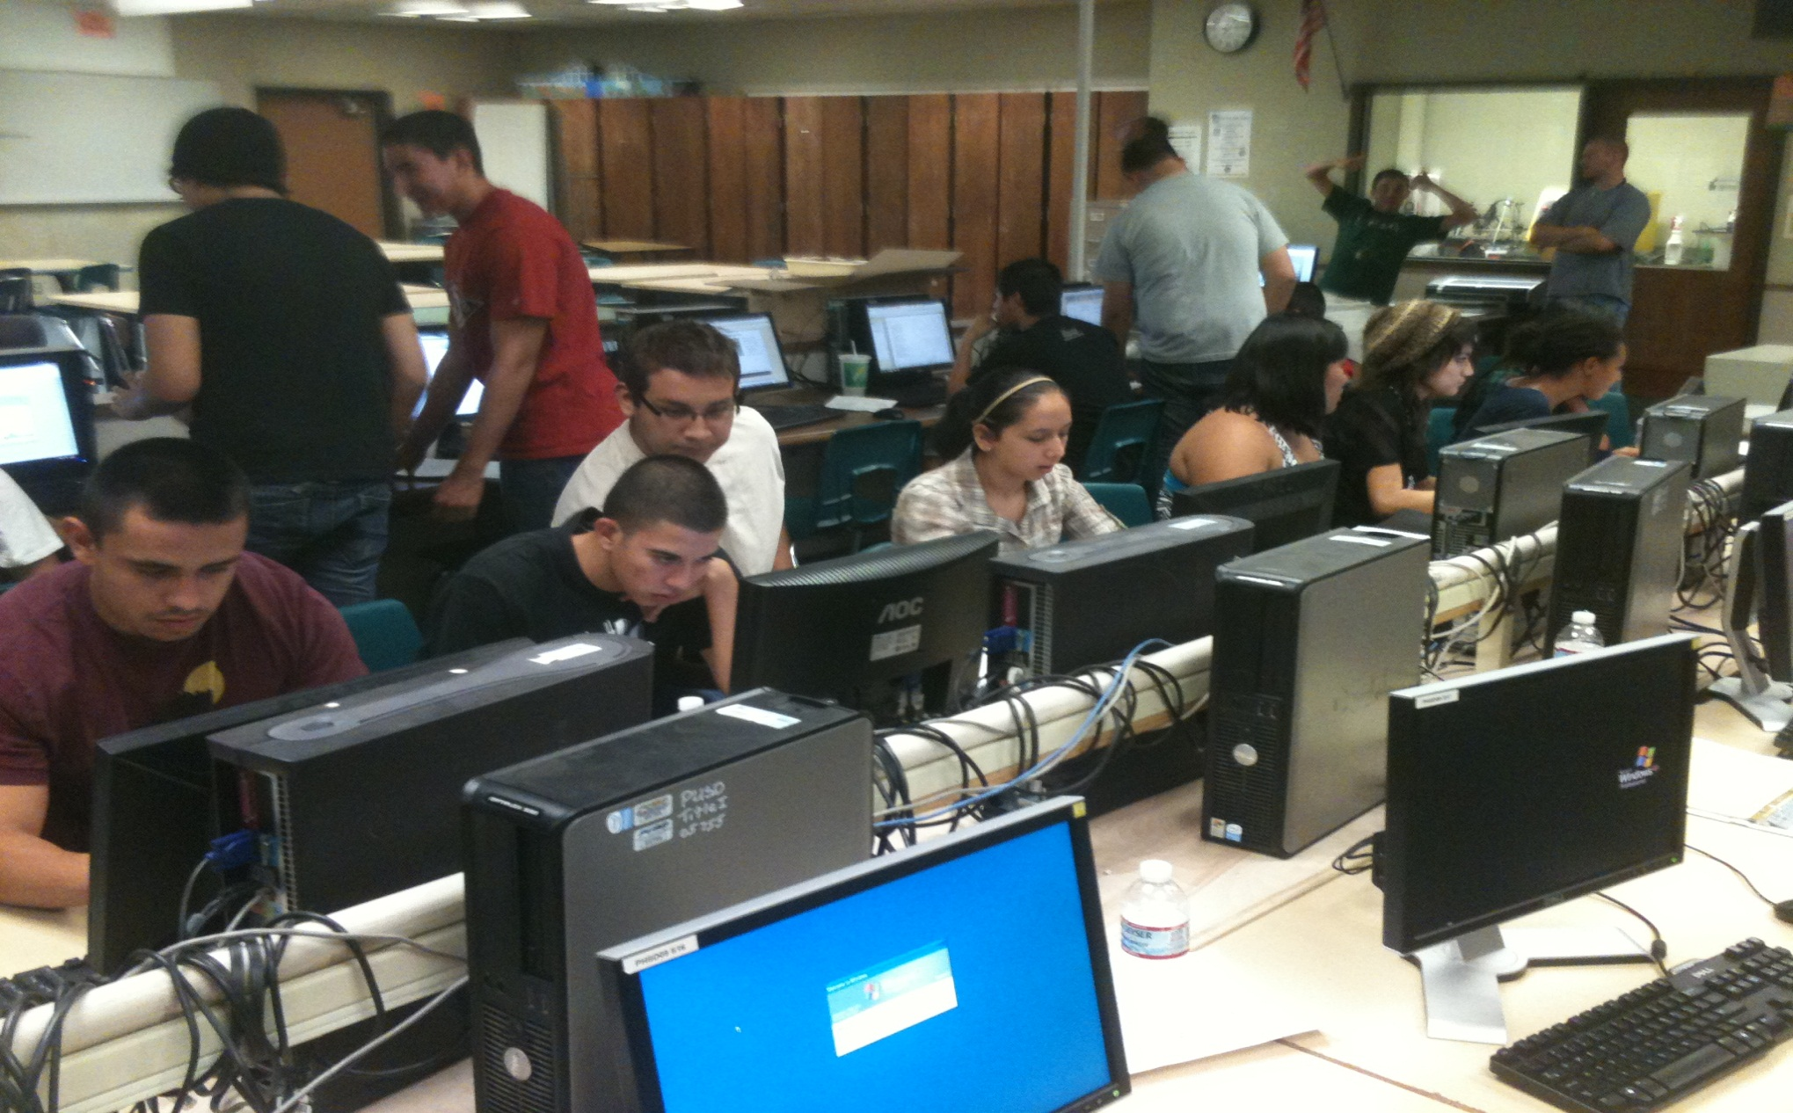
Sunpower Solar Summer Camp-Day Three

Slide 20
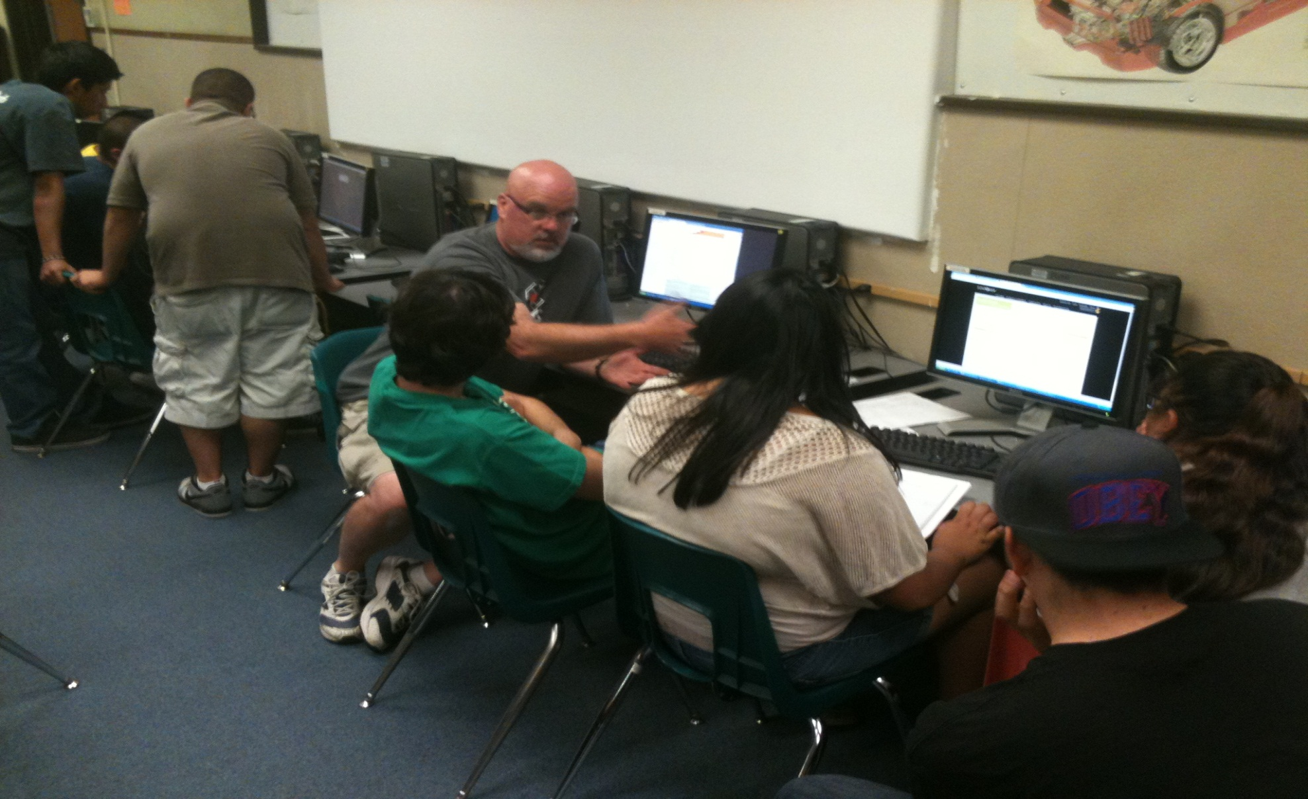
Sunpower Solar Summer Camp-Day Three

Slide 21
Sunpower Solar Summer Camp-Day Three

Slide 22
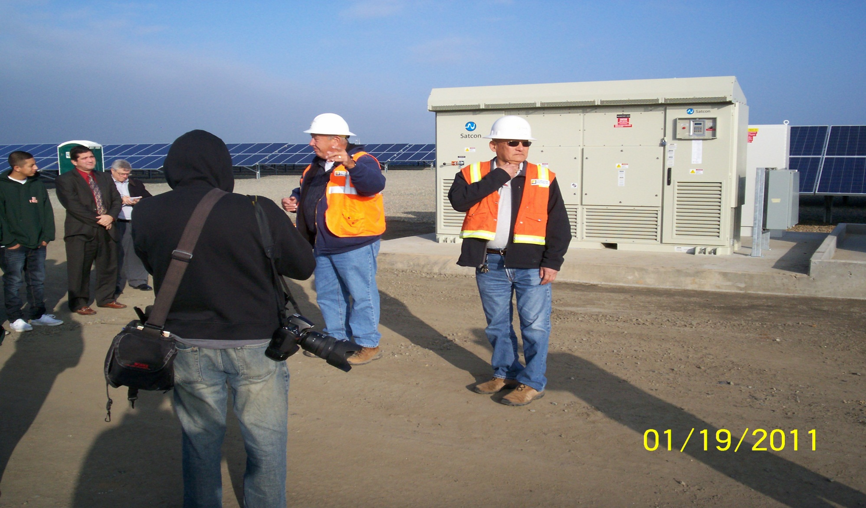
Sunpower Summer Solar Camp-SCE PV Farm Tour Day Three

Slide 23
Sunpower Solar Summer Camp-Day Three

Slide 24
Sunpower Solar Summer Camp-Day Four
Hands-on Laboratory-Sunpower Solar Energy Lab
“One Million Lights” Activities - #1 - 4
Bobby Ram-brief history of Sunpower Corporation
Afternoon
Project Design Brief
Student teams continue work on presentations,

Slide 25
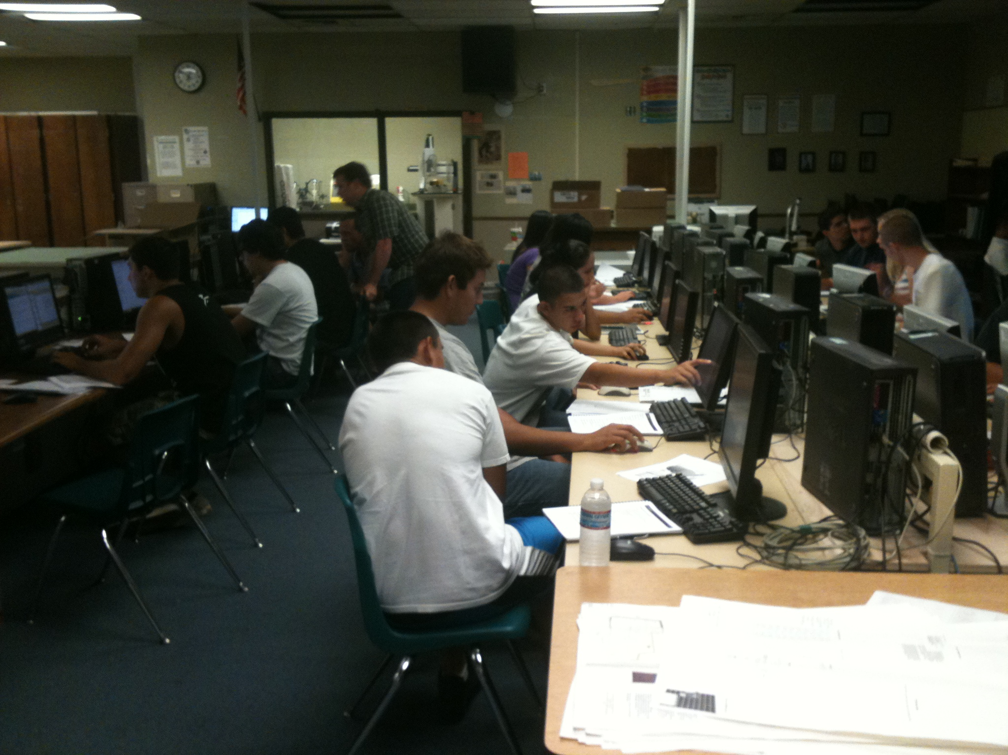

Slide 26
Sunpower Solar Summer Camp-Day Five
Morning Session: Keynote Address-Economic Development & Cluster Development: Workforce Investment Board-Green Jobs
Begin Student Presentations-semi-finals. Industry-juried based on judging rubric. The top three teams will be chosen to advance to Final Presentation Event.
Culminating Event will be Final round of Presentations. Parent and family members are invited to watch this event.

Slide 31
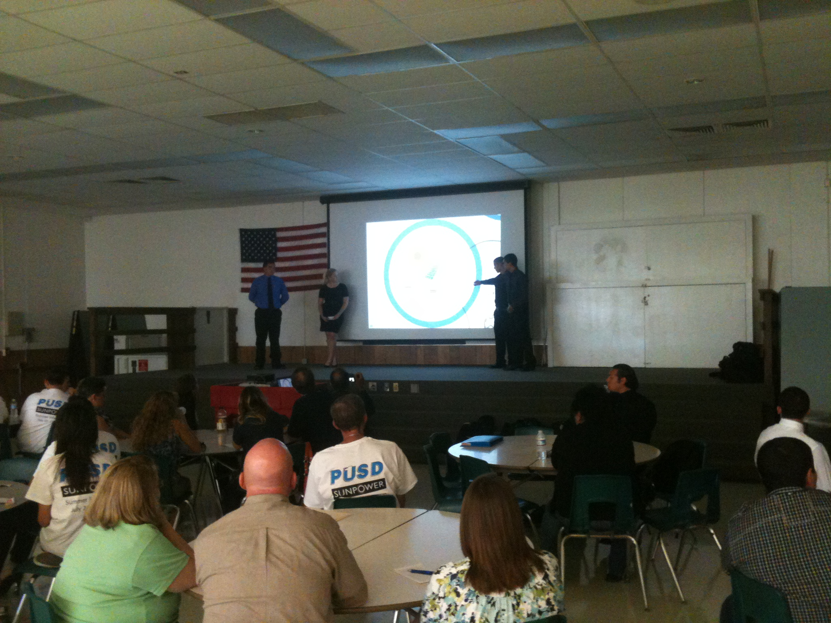

Slide 32
Porterville High School Alternative Energy Resource Occupations (AERO) CPA “Green” Academy
Contact Information:
Porterville High School AERO Academy
465 West Olive Avenue
Porterville, CA 93257 (559)793-3498
Steve Graybehl-Principal
Christine Amann-Asst. Principal, AERO administrator
Raul Bermudez-Guidance Counselor
Brad Collins-CTE Instructor brad.collins@portervilleschools.org
Tom Reed-CTE Instructor treed@portervilleschools.org
Michael Beebe-English Instructor

